Slide 1




Pitch 3
Alixander Roden (Group 4)

Slide 2
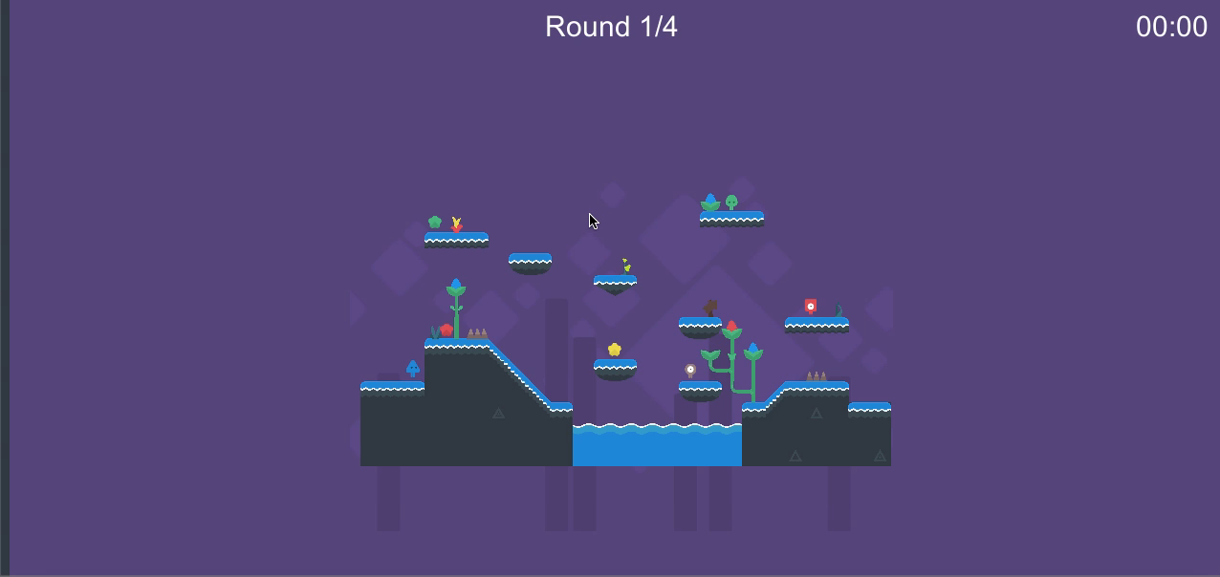
Prototype Demo WIP

Slide 3
What is the core game loop?
Competitive 4 player ”battle” game
Gain the most points within a round to win that round
3 Rounds consisting of different mechanics
1 Round consisting of all mechanics
Overall winner is decided at the end
Learn/Practice/Master

Slide 4
Who is the game for?
Casual Gamers
Interested in ”party” games
Family Friendly (11+)
Young Adults / Console Gamers
Achievers, Explorers, Socializers and Killers

Slide 5
Visual Style
Since I am not a designer I am using free assets for my game
The asset pack I am using provides 4 different styles of platformer elements
Cartoony style suitable for family friendly games
Also serious enough for casual gamers/party
Each round will have a different visual style from the other, mainly due to the change in color scheme
Possibility to introduce

Slide 6
Visual Style

Slide 7
What are my competitors?
Difficult to identify competitors
Game idea seems original
Similar games however include:
Mario Chase for Wii U
Demons with Shotguns
TowerFall Ascension

Slide 8

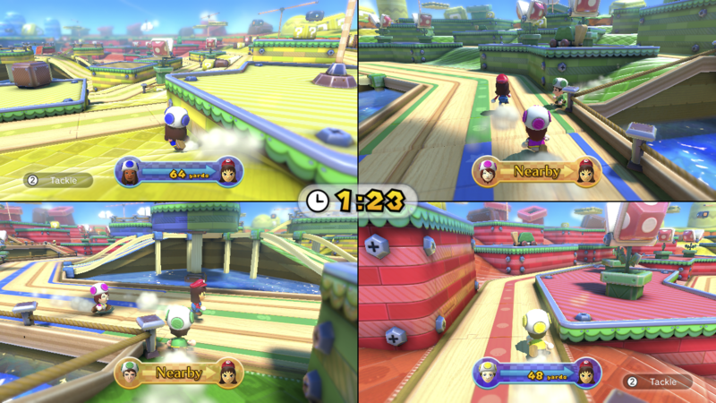
Mario Chase
Co-Operative/Couch-Coop Game
4 Players run around a map, chasing a player. Similarly in my game, 4 players run around a map chasing the player with the best item
3D TopDown
Consists of different Stages which have different layouts and hiding areas
Each round/stage has a timer

Slide 9
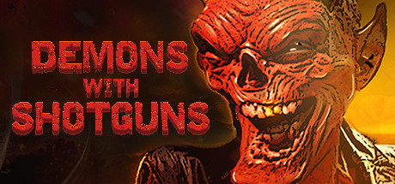
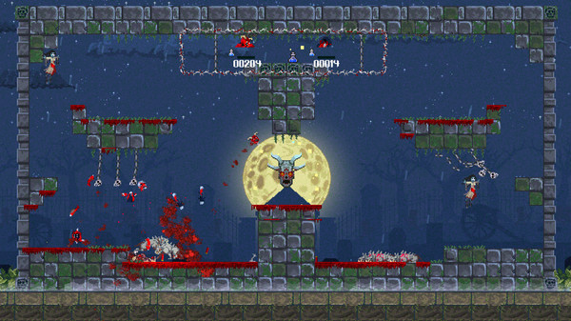
Demons with Shotguns
Couch co-op shooter/fps game
Players chase each other around a platform based 2D map with shotguns
All 4 players can be seen at any time because the camera zooms in and out and follows the players
Very similar style to the levels for my game
However the game is very serious and adult

Slide 10
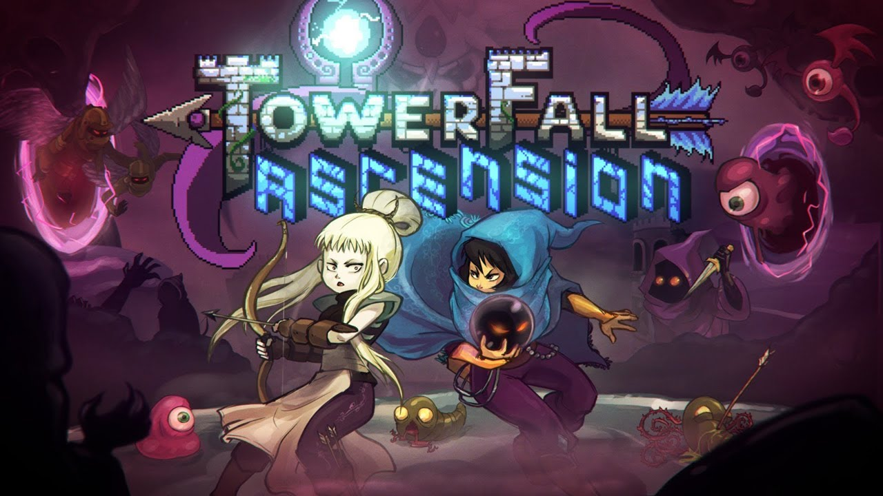
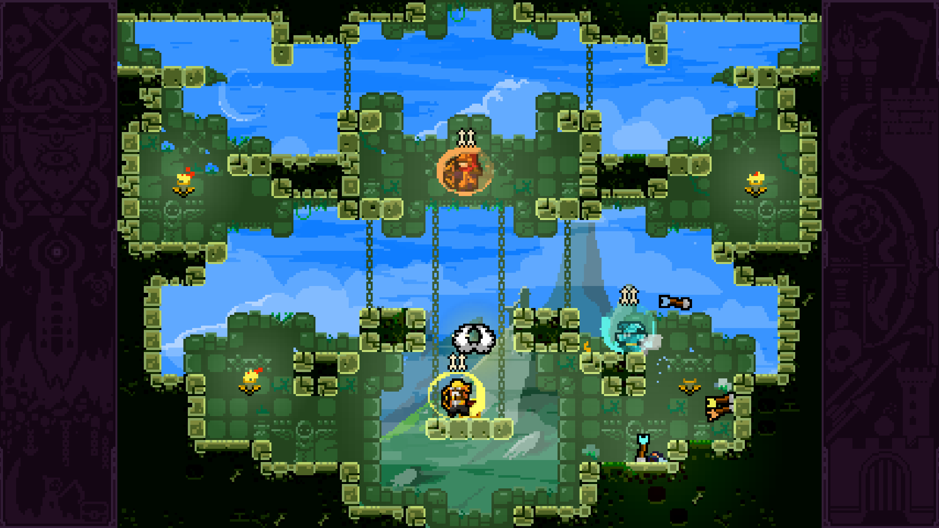
TowerFall Ascension
2D 4 player local party game
Players fight on platform based levels with bows and arrows
“Battle Royale” game

Slide 11
What should my game include from my analysis of competitors?
Multiplayer follow camera, the camera in my game should zoom in and out so that all players can be seen at any given time
2D “retro” art style
Powerups (items) should be varied and interesting
Gameplay should be simple and easy to understand after a practice round

Slide 12
Project Timeline
4th February 2019 (Pitch 4)
Fully working prototype with all 4 rounds working
Tested by casual gamers, possibility of testing with family friendly target (11+)
If polished could be the MVP
Feature complete by Pitch 5

Slide 13
Any Questions?

